Slide 1
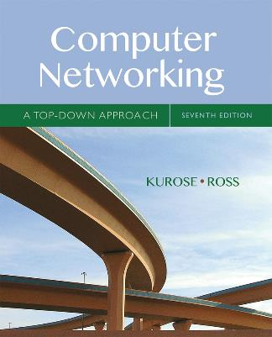
Chapter 6 The Link Layer
and LANs
A note on the use of these Powerpoint slides:
We’re making these slides freely available to all (faculty, students, readers). They’re in PowerPoint form so you see the animations; and can add, modify, and delete slides (including this one) and slide content to suit your needs. They obviously represent a lot of work on our part. In return for use, we only ask the following:
Computer Networking: A Top Down Approach
If you use these slides (e.g., in a class) that you mention their source (after all, we’d like people to use our book!)
If you post any slides on a www site, that you note that they are adapted from (or perhaps identical to) our slides, and note our copyright of this material.
Thanks and enjoy! JFK/KWR
All material copyright 1996-2016
J.F Kurose and K.W. Ross, All Rights Reserved
7th edition Jim Kurose, Keith Ross Pearson/Addison Wesley April 2016

Slide 2








Link layer
A device that runs a link layer protocol is called a node (such as host, router, switch). Every node has a Network Interface Card (NIC).
A communication channel than connects two nodes is called a links
Datagram from Network layer + Header information = frame

Slide 3
Link layer services
Framing and link access
Framing: datagram + header = frame
For every NIC, there is a MAC address
reliable delivery transfer
error detection and error correction

Slide 4
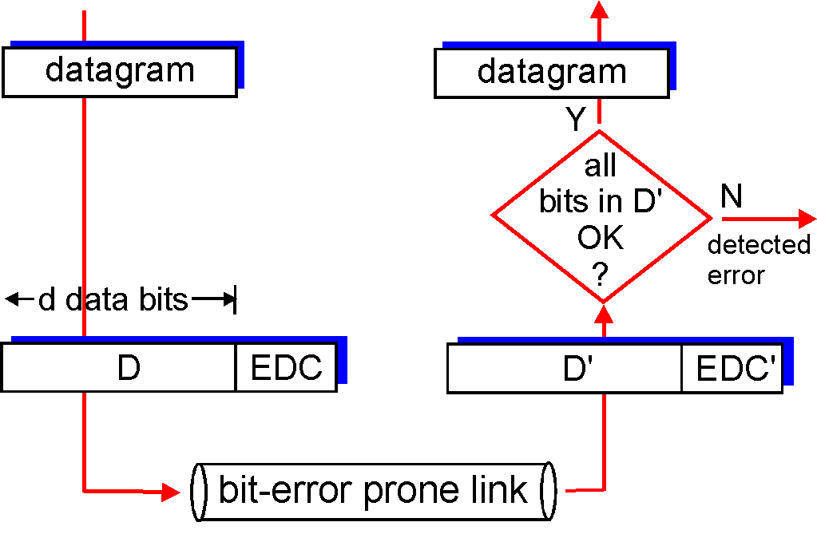
Error detection and correction
EDC= Error Detection and Correction bits
D = Data
Three approaches: Parity, checksum and Cyclic Redundancy Check (CRC)
Yes

Slide 5
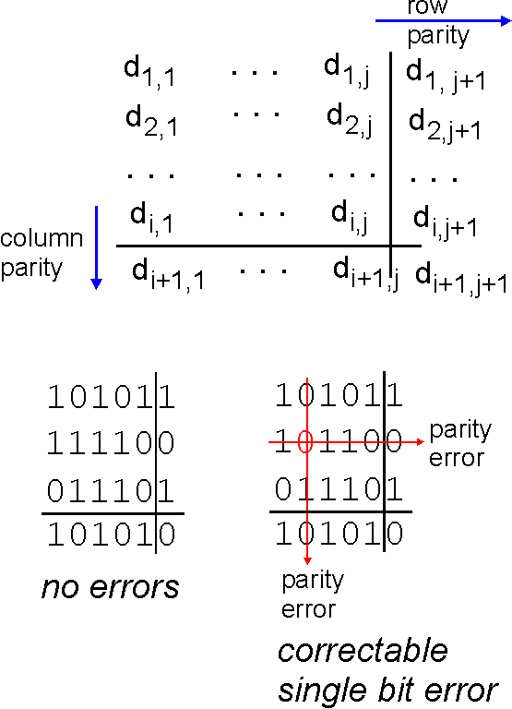
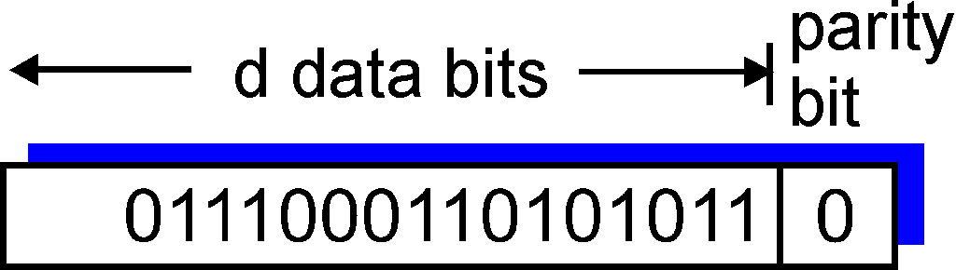
Parity checking
single bit parity:
Even parity: number of 1s including the parity bit is even
In the receiver side, if the number of 1s is not even, then there is a odd number of bits altered. How about if even number of 1s altered?
two-dimensional bit parity:
detect and correct single bit errors
0
0
* Check out the online interactive exercises for more examples: http://gaia.cs.umass.edu/kurose_ross/interactive/

Slide 6
Checksum
We studied this in Chapter 3 Transport Layer.

Slide 7
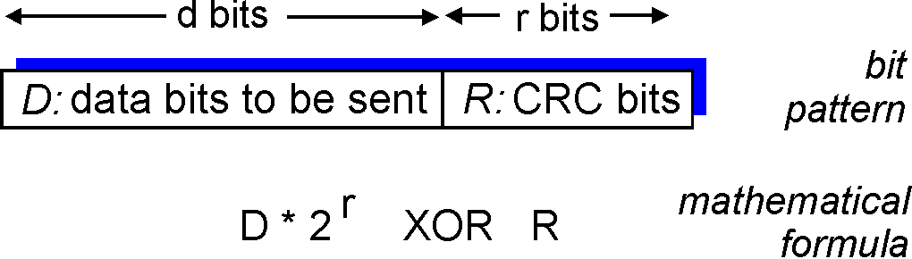
Cyclic redundancy check
data = D
r+1 bits generator = G (both sender and receiver know)
choose r CRC bits, R, such that
<D,R> is exactly divisible by G (Carry is never considered)
receiver divides <D,R> by G. If non-zero remainder, then error is detected.

Slide 8
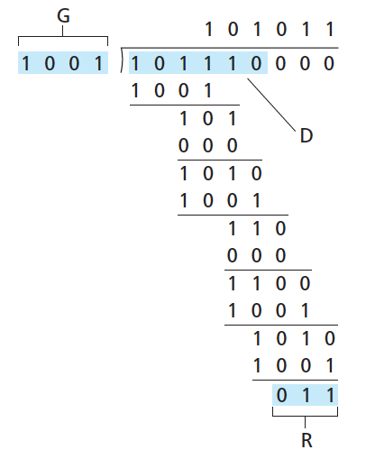
CRC example
We get, <D,R> = D.2^{r} XOR R
We need to find R such that,
D.2^{r} XOR R = nG
=> D.2^{r} = nG XOR R (XOR both side by R)
This gives us:
D.2^{r}
G
R = remainder[ ]
* Check out the online interactive exercises for more examples: http://gaia.cs.umass.edu/kurose_ross/interactive/

Slide 9



Multiple access protocols
two types of links:
point-to-point link
A single sender at one end of the link and a single receiver at the other end of the link
broadcast link
Many senders and many receivers share a single link
shared wire (e.g.,
cabled Ethernet)
shared RF
(e.g., 802.11 WiFi)
shared RF
(satellite)
humans at a
cocktail party
(shared air, acoustical)

Slide 10
Multiple access protocols
Multiple access problem: How to coordinate the access of multiple sending and receiving nodes to a shared broadcast link
If a node receives two or more packets at the same time, all packets are lost. This is called a collision.
We need Multiple Access Protocols
Three types of protocols:
Channel partitioning protocols: TDMA, FDMA
Random access protocols: Slotted ALOHA, ALOHA, CSMA, CSMA/CD
Taking-turns protocols: Polling, token-passing

Slide 11
Multiple access protocols
channel rate = R bps
Our expectation for a multiple access protocol:
1. If there is a single node to send packets, the node can send at rate R.
2. When M nodes want to transmit, each can send at average rate R/M
3. There should be no master node to coordinate transmissions
4. The protocol should be simple

Slide 12
Time Division Multiple Access (TDMA)
Time is divided into time frames
Each time frame is divided into N time slots (if we have N nodes)
Each time slot is assigned to each node
Then, each node gets a transmission rate of R/N
If there is only one active node (with packets to send), then rest of the slots are never used
6-slot
frame
6-slot
frame
1
3
4
1
3
4

Slide 13
Frequency Division Multiple Access (FDMA)
The channel with R bandwidth is divided into N smaller channels (if we have N nodes)
Each node is assigned a channel of R/N bandwidth
If there is only one active node (with packets to send), then rest of the channels are never used
time
frequency bands
FDM cable

Slide 14
Slotted ALOHA
Every node can use the full channel
Time is divided into time slots
When a new packet arrives, a node transmits in the next slot
If 2 or more nodes transmit in a same slot, collision happens
If no collision happens, the node can send the next packet in next the slot
If collision happens, the node retransmits packet in each subsequent slots with probability p until success
node 1
1
1
1
1
node 2
2
2
2
node 3
3
3
3
C
E
C
S
E
C
E
S
S

Slide 15
Slotted ALOHA: efficiency
A node is successful if this node transmits and the remaining N-1 nodes do not transmit
Probability that a node transmits = p
Probability that a node does not transmit = 1-p
Probability that N-1 nodes do not transmit = (1-p)^{N-1}
Probability that a node is successful = p(1-p)^{N-1}
Probability that any one of N nodes is successful = Np(1-p)^{N-1}
find p* that maximizes = Np(1-p)^{N-1}
for many nodes, take limit of Np*(1-p*)^{N-1} as N goes to infinity, gives: max efficiency = 1/e = .37=37%

Slide 16
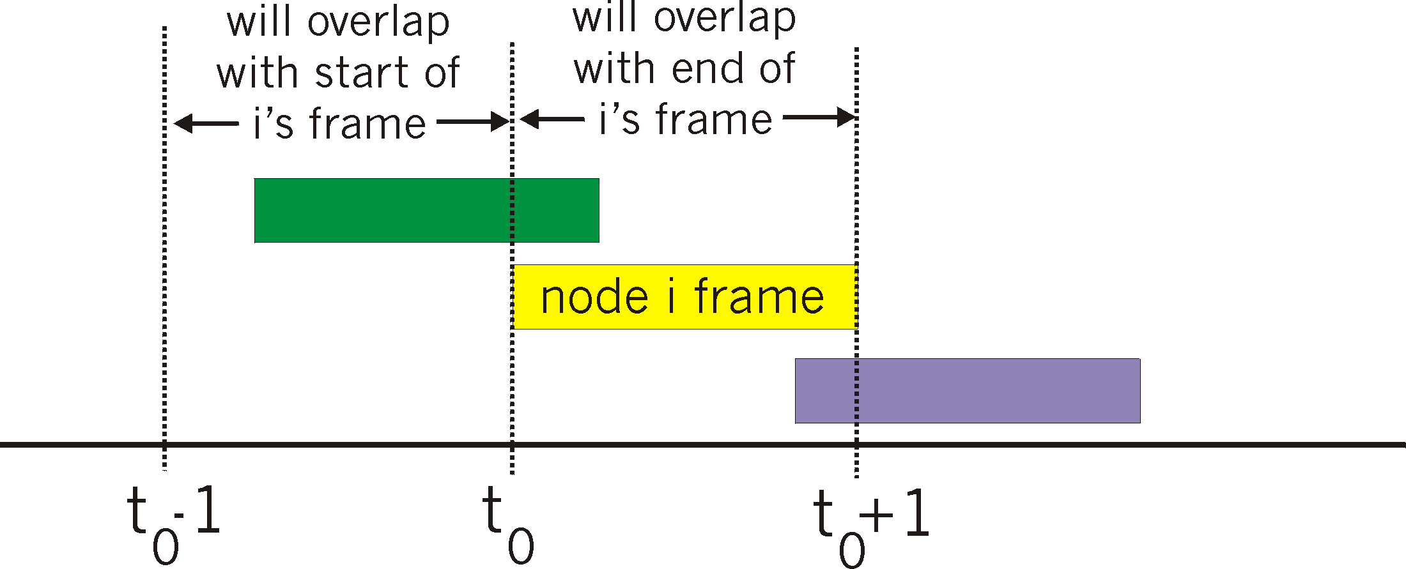
ALOHA
No time slots
When new packet arrives, a node transmits immediately
When a collision occurs, the node retransmits immediately with a probability p
A packet sending at t₀ time is successful if no other node sends another packet in [t₀-1,t₀+1]
Efficiency = 18%

Slide 17
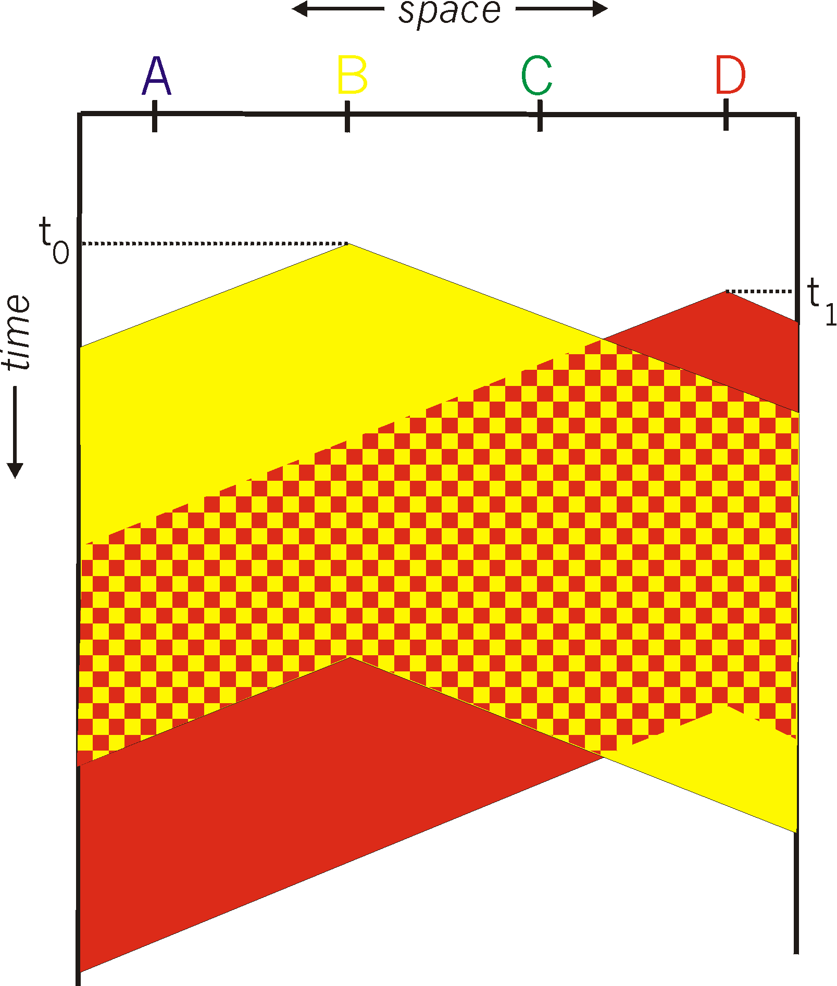
CSMA (Carrier Sense Multiple Access)
spatial layout of nodes
If another node is using the channel, then do not send now.
Theoretically, there should be no collision
But, collisions can still occur due to propagation delay
When collision occurs, all packets are lost

Slide 18
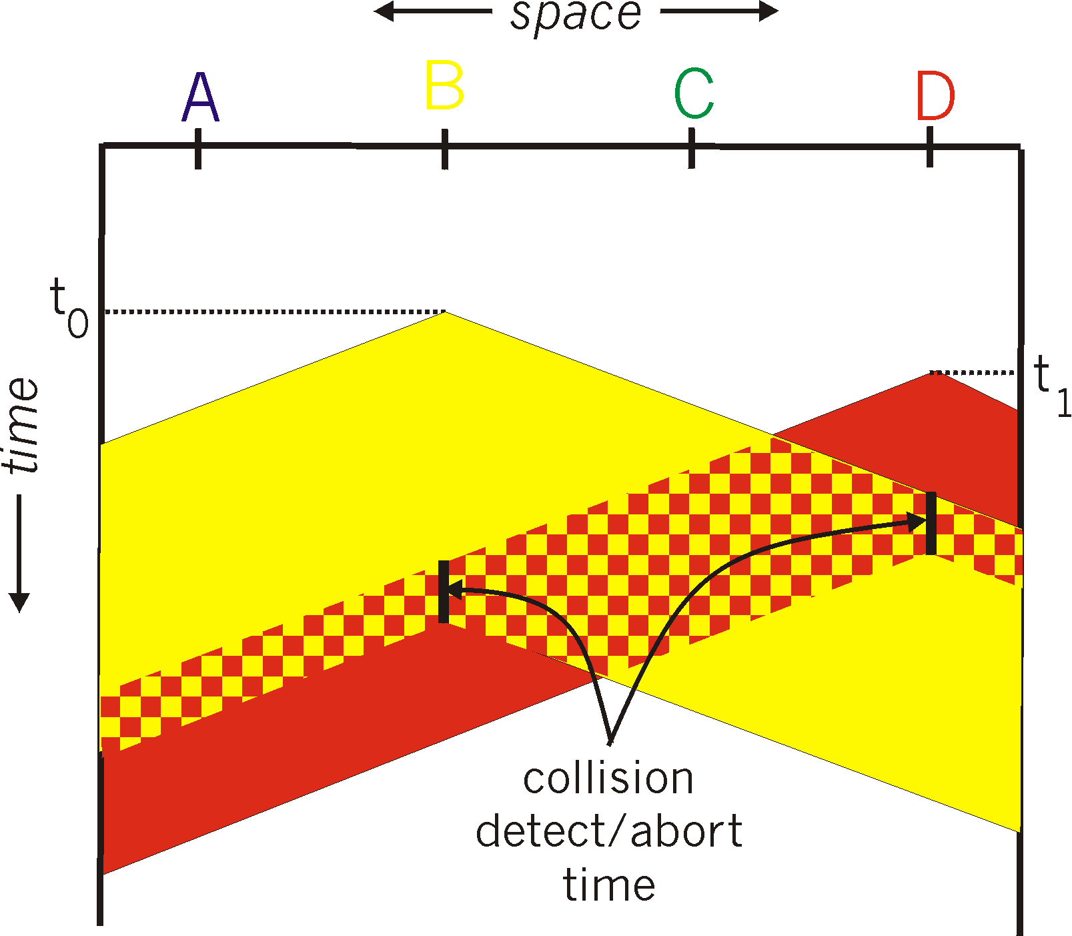
CSMA/CD (CSMA with Collision Detection)
If a collision is detected, then stop sending for a random amount of time.
How to detect collision?
easy in wired LANs: measure signal strengths, compare transmitted, received signals
difficult in wireless LANs: received signal strength overwhelmed by local transmission strength
spatial layout of nodes

Slide 19
CSMA/CD efficiency
t_{prop} = max prop delay between 2 nodes in LAN
t_{trans} = time to transmit max-size frame
efficiency goes to 1
as t_{prop} goes to 0
as t_{trans} goes to infinity
better performance than ALOHA: and simple, cheap, decentralized!

Slide 20

Polling protocol
There is a master node that sends a message to node 1 that node 1 can transmit a maximum number of packets; then node 2; node 3;…;node n; node1
Problems:
polling delay: If there is a single active node, then the transmission rate will be less than R
The entire channel fails if the master node fails
data
poll
master
data
slaves

Slide 21
Token-passing protocol
Token is a small, special purpose packet
If a node has the token, it can transmit a maximum number of packets, and no other node can transmit
Then, it passes the token to the next node
Problems:
If a node fails, the entire channel will fail
Token delay
T
(nothing
to send)
T
data

Slide 22
LAN: Addressing
Each node in a LAN has a 48-bits MAC address.
This address never changes.
How to send packet from one node to another?
Sending node includes the MAC address of destination node with the frame, and broadcasts the frame.
All nodes receive the frame.
In a node, if the MAC address matches, the frame is accepted;
If the MAC address does not match, the frame is discarded.

Slide 23

LAN: Addressing
1A-2F-BB-76-09-AD
LAN
(wired or
wireless)
adapter
71-65-F7-2B-08-53
58-23-D7-FA-20-B0
0C-C4-11-6F-E3-98

Slide 24




LAN: ARP
Address Resolution Protocol (ARP) translate a IP address to a MAC, within a LAN (subnet)
Every node has an ARP table, mapping from IP address to MAC address
An ARP table is automatically generated
137.196.7.78
1A-2F-BB-76-09-AD
137.196.7.23
137.196.7.14
LAN
71-65-F7-2B-08-53
58-23-D7-FA-20-B0
0C-C4-11-6F-E3-98
137.196.7.88

Slide 25
LAN: ARP
If a node A does not have the MAC address of another node B, then the node broadcasts an ARP packet with the IP address of B.
All nodes receive the ARP packet
Only node B replies to A with its MAC address
Then, the ARP table of A is updated

Slide 26




Sending a datagram to another subnet
datagram from A to B via R
A
B
R
111.111.111.111
222.222.222.222
74-29-9C-E8-FF-55
49-BD-D2-C7-56-2A
222.222.222.220
1A-23-F9-CD-06-9B
111.111.111.112
111.111.111.110
222.222.222.221
CC-49-DE-D0-AB-7D
E6-E9-00-17-BB-4B
88-B2-2F-54-1A-0F

Slide 27
Sending a datagram to another subnet
A creates datagram with IP source A, destination B
A creates frame with R's MAC address as destination address, frame contains A-to-B IP datagram
MAC src: 74-29-9C-E8-FF-55
MAC dest: E6-E9-00-17-BB-4B
IP
Eth
Phy
IP src: 111.111.111.111
IP dest: 222.222.222.222
A
B
R
111.111.111.111
222.222.222.222
74-29-9C-E8-FF-55
49-BD-D2-C7-56-2A
222.222.222.220
1A-23-F9-CD-06-9B
111.111.111.112
111.111.111.110
222.222.222.221
CC-49-DE-D0-AB-7D
E6-E9-00-17-BB-4B
88-B2-2F-54-1A-0F

Slide 28
Sending a datagram to another subnet
The frame is sent from A to R
R retrieves the datagram
MAC src: 74-29-9C-E8-FF-55
MAC dest: E6-E9-00-17-BB-4B
IP src: 111.111.111.111
IP dest: 222.222.222.222
IP
Eth
Phy
IP src: 111.111.111.111
IP dest: 222.222.222.222
IP
Eth
Phy
A
B
R
111.111.111.111
222.222.222.222
74-29-9C-E8-FF-55
49-BD-D2-C7-56-2A
222.222.222.220
1A-23-F9-CD-06-9B
111.111.111.112
111.111.111.110
222.222.222.221
CC-49-DE-D0-AB-7D
E6-E9-00-17-BB-4B
88-B2-2F-54-1A-0F

Slide 29
Sending a datagram to another subnet
R forwards datagram from one port to another
R creates frame with B's MAC address as destination address, frame contains A-to-B IP datagram
MAC src: 1A-23-F9-CD-06-9B
MAC dest: 49-BD-D2-C7-56-2A
IP
Eth
Phy
IP
Eth
Phy
IP src: 111.111.111.111
IP dest: 222.222.222.222
A
B
R
111.111.111.111
222.222.222.222
74-29-9C-E8-FF-55
49-BD-D2-C7-56-2A
222.222.222.220
1A-23-F9-CD-06-9B
111.111.111.112
111.111.111.110
222.222.222.221
CC-49-DE-D0-AB-7D
E6-E9-00-17-BB-4B
88-B2-2F-54-1A-0F

Slide 30
Sending a datagram to another subnet
R forwards datagram from one port to another
R creates frame with B's MAC address as destination address, frame contains A-to-B IP datagram
MAC src: 1A-23-F9-CD-06-9B
MAC dest: 49-BD-D2-C7-56-2A
IP
Eth
Phy
IP
Eth
Phy
IP src: 111.111.111.111
IP dest: 222.222.222.222
A
B
R
111.111.111.111
222.222.222.222
74-29-9C-E8-FF-55
49-BD-D2-C7-56-2A
222.222.222.220
1A-23-F9-CD-06-9B
111.111.111.112
111.111.111.110
222.222.222.221
CC-49-DE-D0-AB-7D
E6-E9-00-17-BB-4B
88-B2-2F-54-1A-0F

Slide 31
Sending a datagram to another subnet
R forwards datagram from one port to another
R creates frame with B's MAC address as destination address, frame contains A-to-B IP datagram
MAC src: 1A-23-F9-CD-06-9B
MAC dest: 49-BD-D2-C7-56-2A
IP src: 111.111.111.111
IP dest: 222.222.222.222
IP
Eth
Phy
A
B
R
111.111.111.111
222.222.222.222
74-29-9C-E8-FF-55
49-BD-D2-C7-56-2A
222.222.222.220
1A-23-F9-CD-06-9B
111.111.111.112
111.111.111.110
222.222.222.221
CC-49-DE-D0-AB-7D
E6-E9-00-17-BB-4B
88-B2-2F-54-1A-0F
* Check out the online interactive exercises for more examples: http://gaia.cs.umass.edu/kurose_ross/interactive/

Slide 32



Ethernet: A LAN technology
Speed: 10 Mbps – 10 Gbps
Physical topology:
bus: All nodes are in same collision domain and can collide with each other
star: active switch in center. Nodes do not collide with each other
switch
star
bus: coaxial cable

Slide 33
Ethernet frame structure
type
dest.
address
source
address
data (payload)
8 bytes preamble : 7 bytes with pattern 10101010 and one byte with 10101011. It is used to synchronize receiver and sender clock rates, due to different transmission rate
addresses: 6 byte source and 6 bytes destination MAC addresses
type: Indicates Network Level protocols
CRC: cyclic redundancy check
preamble
CRC

Slide 34
Ethernet
Some features:
connectionless: no handshaking between sending and receiving NICs
unreliable: receiving NIC doesn't send acks or nacks to sending NIC
CSMA/CD MAC protocol

